Slide 1
Intelligent Traffic Violation Detection and Explanation System
Submitted in the partial fulfillment for the award of the degree of
BACHELOR OF ENGINEERING
IN
COMPUTER SCIENCE WITH SPECIALIZATION IN
ARTIFICIAL INTELLIGENCE AND MACHINE LEARNING
Submitted by:
Srishti Kaur 22BAI70036
Muskan 22BAI71150
Under the Supervision of:
Dr. Preeti
Department of AIT-CSE
DISCOVER . LEARN . EMPOWER

Slide 2

Outline
Introduction to Project
Problem Formulation
Objectives of the work
Methodology used
Results and Outputs
Conclusion
Future Scope
References

Slide 3
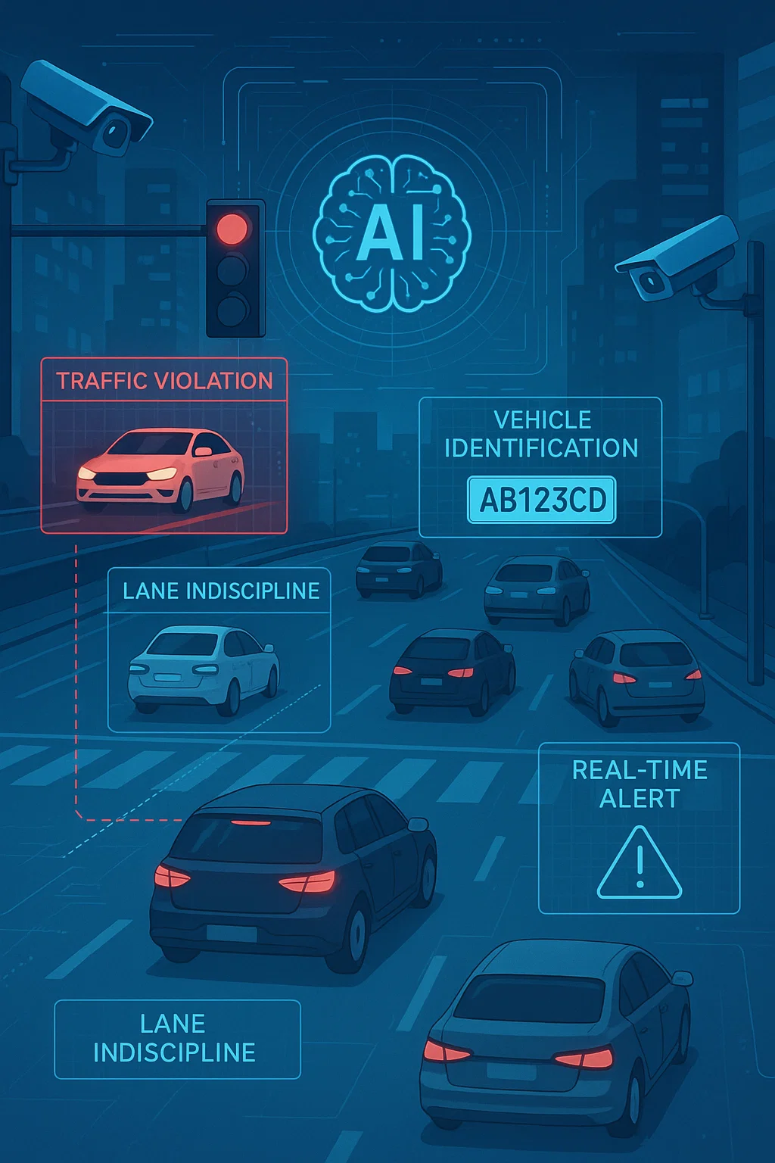
Introduction to Project
Our project aims to build an AI-powered traffic monitoring system that enhances road safety and enforces regulations automatically.
Using computer vision, the system detects violations such as red-light jumping, helmet avoidance, and lane indiscipline from video feeds. Detected incidents are linked with Automatic Number Plate Recognition (ANPR) and OCR to accurately identify vehicles, even under challenging conditions.
A structured, legally compliant report is then generated with the help of Large Language Models (LLMs), including violation details, vehicle information, and supporting evidence.
Additional features such as vehicle history tracking, real-time notifications, and a searchable database empower authorities to efficiently monitor, analyze, and act on traffic violations.

Slide 4
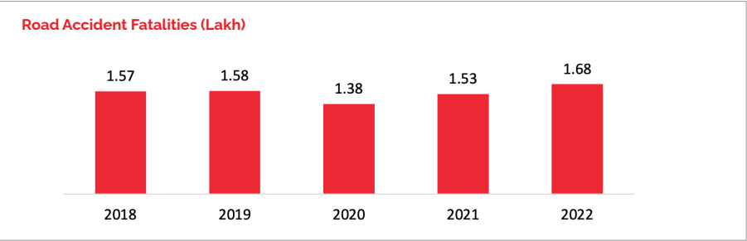
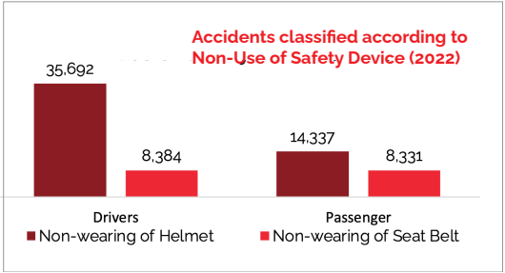
The data on road accident fatalities in India from 2018 to 2022 reflects an alarming trend, rising from 1.57 lakh in 2018 to 1.68 lakh in 2022. In contrast, there was a noticeable dip in 2020 to 1.38 lakh, likely attributable to reduced vehicular movement during the COVID-19 lockdowns.
The number of deaths due to not wearing helmets is significantly higher, highlighting the critical role of helmet use in preventing fatalities.
Deaths due to not wearing seat belts are relatively similar emphasizing the need for stricter enforcement of seatbelt use for all vehicle occupants.
So, there is a need for an automated system which uses AI, Computer Vision, and OCR. This system will detect helmet violations, lane indiscipline, and red-light jumping etc.
Plus, it also supports Smart City initiatives with potential for patents and publications.

Slide 5
Problem Formulation
Traffic management systems in most cities rely heavily on manual observation by traffic police or basic surveillance cameras that only record footage without intelligent analysis. This creates several problems:
Manual Monitoring Limitations
Inefficient Evidence Collection
Repeat Offenders Not Tracked
Delayed Action
With a population of more than 1.3 billion within the geographical area of 3.1 million square kilo meters and with the increasing vehicles and traffic congestion.
The manual controlling of such huge traffic is not adequate
In manual systems, violations are detected after the event has occurred. Because evidence takes time to review and follow through, offenders typically avoid consequences for their actions.
Traditional surveillance cameras just capture footage with no intelligence. It takes a lot of time to retrieve footage and connect violations to specific vehicles, and sometimes those violations are never pursued at all.
Manual systems typically do not track or maintain databases or histories of offenders. Thus, without automation, there are no tracking mechanisms for repeat offenders, nor mechanisms to alert officials of repeat violations.

Slide 6
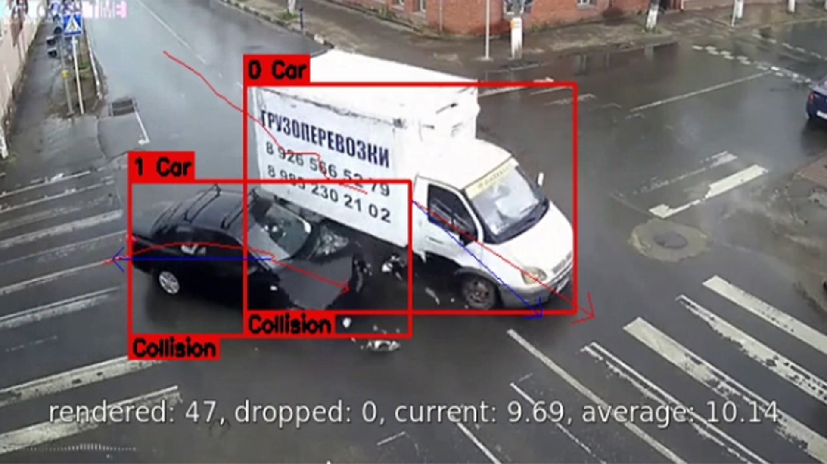
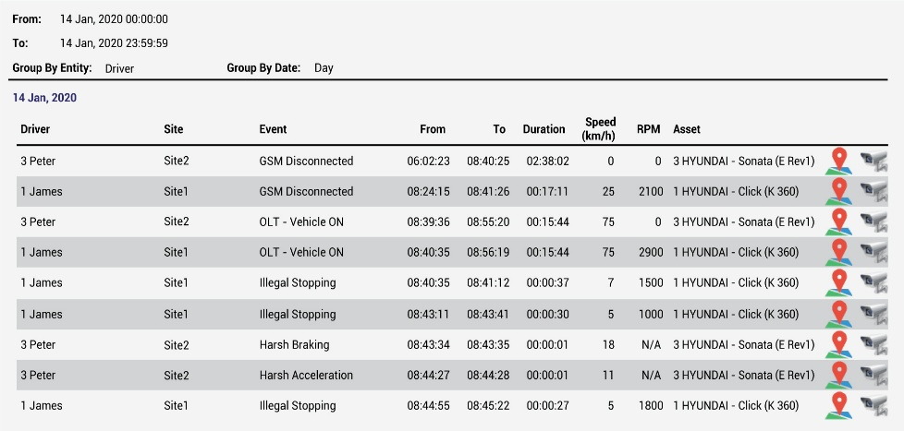
So, to deal with these problems. We have introduced our INTELLIGENT TRAFFIC VIOLATION DETECTION AND EXPLANATION SYSTEM
We have AI-based Violation Detection and Automatic Number Plate Recognition which uses Computer Vision to detect any traffic violations like red-light jumping, switching lanes or no-helmet driving. We also use Optical Character Recognition to extract the number plate of the violating vehicle.
To deal with the problem of delays and lack of evidence, we have Report Generation using LLMs. After identifying the vehicle and violation, a structured report is generated automatically. The report includes details such as violation type, time, date, location of incident, vehicle number, legal reference and contextual evidence snapshots or video snippets as attachments.
We also include Vehicle history tracking to monitor repeated offenses. Central database tracks historical violations linked to vehicles and owners. Real-time notifications to authorities for repeat offenders, stolen vehicles, or serious infractions

Slide 7
Objectives of the Work
Automatic Violation Detection - Use Computer Vision (CV) techniques to detect traffic violations including helmet violations, lane indiscipline and red-light jumping.
Number Plate Recognition - Use Optical Character Recognition (OCR) capabilities to extract vehicle number plates from video footage of violations.
Violation Report Generation - Use Large Language Models (LLMs) to generate a structured violation report of the offence with legal explanations.
Database Integration - Store violations in a database to help maintain vehicle history tracking.
Dashboard & Query System - Provide a user interface to look up vehicle numbers, generate alerts and visualize findings/statistics.
Scalability & Real-time Deployment - Build the system with the sufficient capacity to allow future integration with CCTV/edge devices requiring real-time deployment. 17
Contribution to Smart Cities - Contribute to the growth of Smart City development with the potential for patents and research publications from this project.

Slide 8

Datasets Used
BDD100K (Berkeley DeepDrive) –
Large-scale driving video dataset with images and annotations.
Helmet Detection Dataset (Kaggle) –
Contains labeled images for helmet vs. no-helmet classification.
License Plate Detection Dataset (Kaggle) –
Dataset for license plate localization and recognition tasks.
Traffic Violation Images Dataset (Kaggle) –
Images for traffic violations like red-light jumping and lane violations.

Slide 9
Important Libraries Used
ultralytics — YOLOv8 object detection model training.
easyocr — Optical Character Recognition for number plate reading.
fiftyone — Dataset visualization, inspection, and YOLO format export.
mysql.connector — MySQL database connectivity.
datetime — Timestamp generation.
openai — Human-readable violation report generation.
gradio — Interactive interface for images and videos.
sklearn.metrics — Accuracy, Precision, Recall, F1-score evaluation.
cv2 (OpenCV) — Image/video processing and visualization.
numpy — Numerical computations.

Slide 10
Methodology used
Step 1: Video Input
Input is taken from recorded video files (initial phase).
Future scope: integrate live CCTV camera feeds or edge devices.
Step 2: Preprocessing
Extract video frames.
Apply noise reduction and normalization to improve detection accuracy.
Step 3: Object Detection
Use YOLO/Detectron2 for detecting:
Vehicles (cars, bikes).
Helmets (helmet vs no-helmet).
Lane/Traffic signals.
Step 4: Violation Check Apply rule-based mapping with traffic laws:
No helmet → Helmet violation.
Vehicle crossing red signal → Red-light jumping.
Wrong lane → Lane indiscipline.
Step 5: OCR (Number Plate Recognition)
Use EasyOCR / Tesseract to detect and extract the vehicle registration number from the detected vehicle.
Step 6: Report Generation
Use LLM (Large Language Model) to:
Summarize the violation.
Add legal explanation (based on traffic rules).
Generate a structured report (PDF/Doc).
Step 7: Database Storage
Store:
Vehicle number.
Type of violation.
Date & time.
Generated report.
Step 8: Dashboard & Query System
Dashboard to:
Search by vehicle number.
Track repeat offenders. Generate alerts (e.g., for stolen vehicles).
Show visualization (graphs, logs).

Slide 11
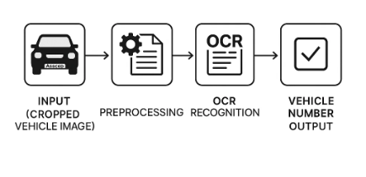
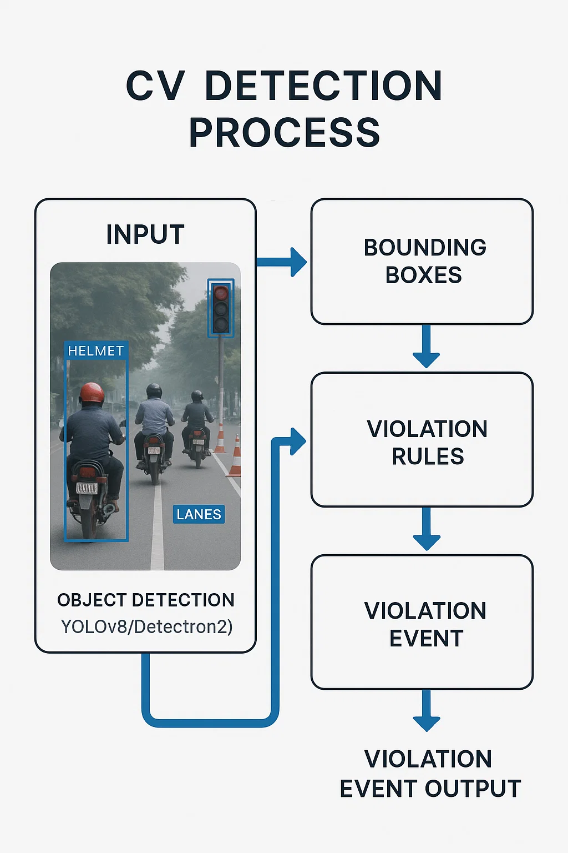
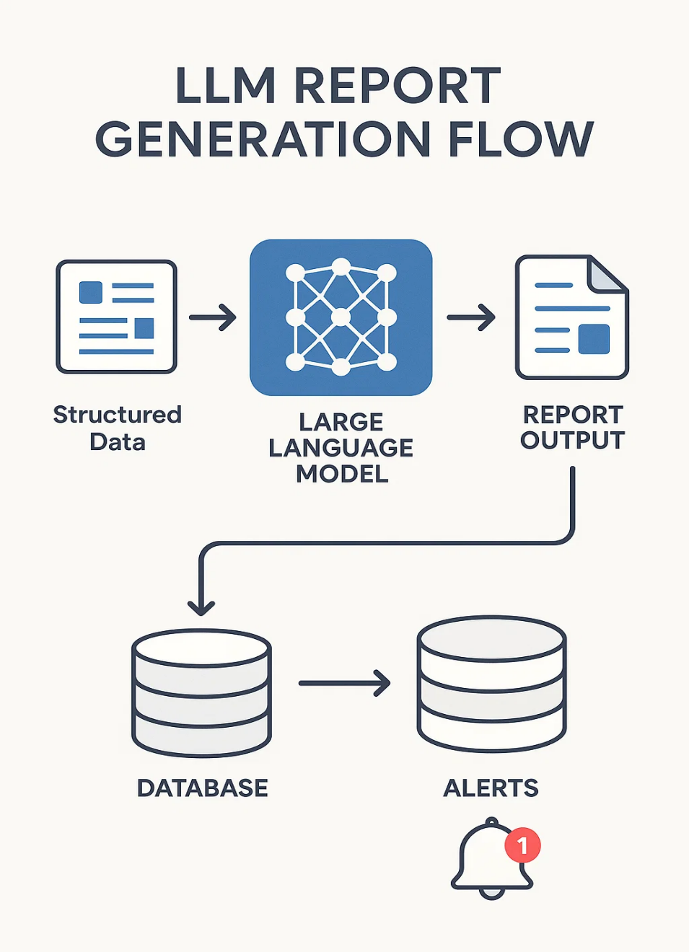

Slide 12
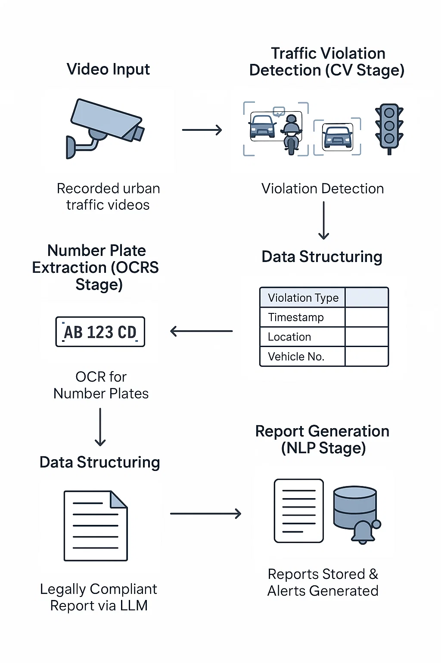
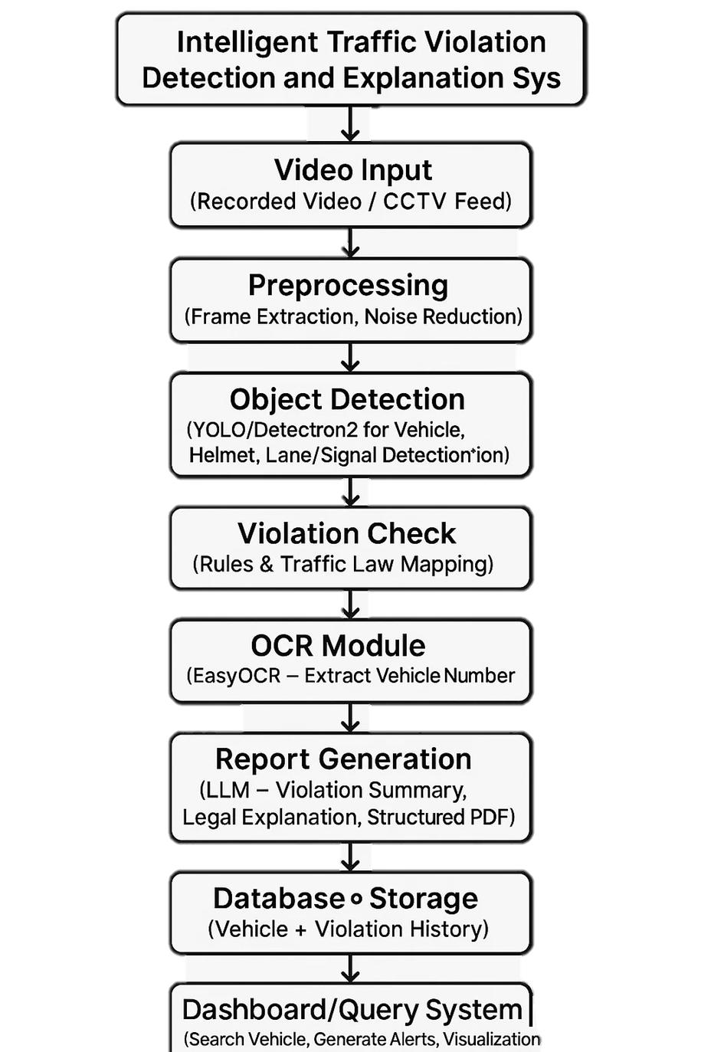

Slide 13
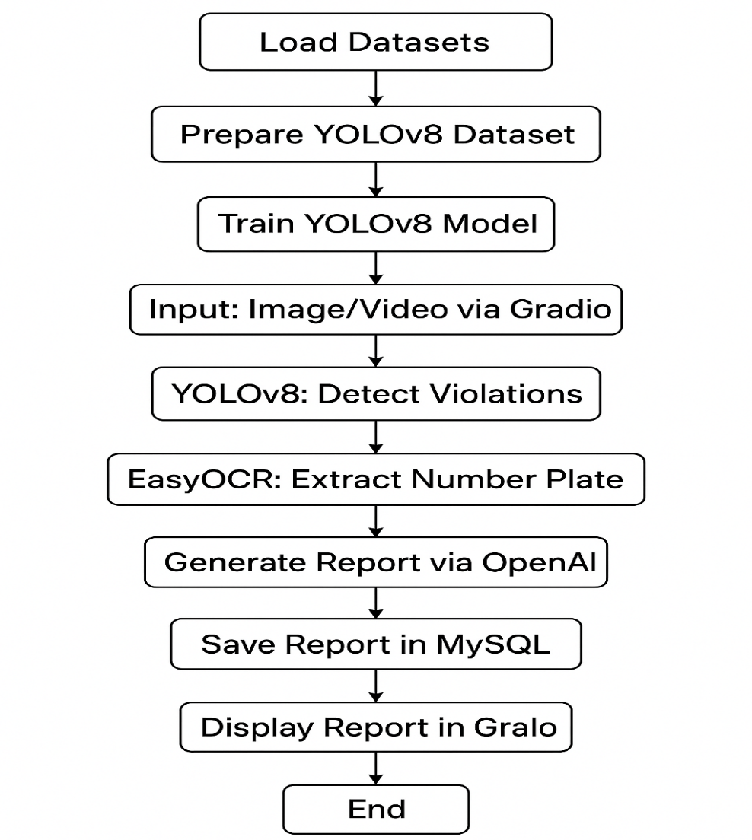
Results and Outputs
Integrated multiple datasets for traffic violation detection.
Used YOLOv8 for object detection (helmet, red light, lane violations).
Applied EasyOCR for accurate number plate recognition.
Generated automated violation reports stored in a MySQL database.
Evaluated system performance using Accuracy, Precision, Recall, and F1-score.
Achieved real-time detection capability for both images and videos.

Slide 14
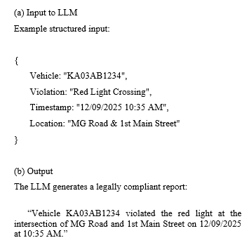
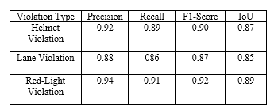
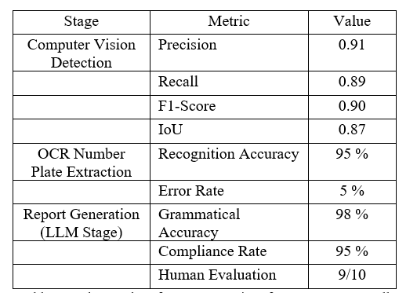
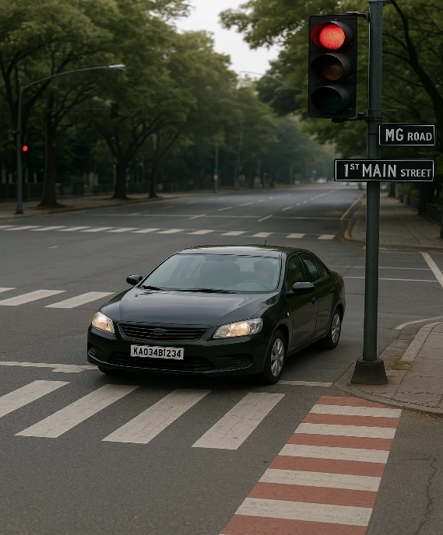

Slide 15
Conclusion
This project successfully demonstrates an AI-powered traffic violation detection and reporting system that integrates Computer Vision, OCR, and LLMs into a single workflow.
The system is capable of detecting major traffic violations such as helmet avoidance, lane indiscipline, and red-light jumping.
It extracts vehicle number plates using OCR and generates a legally compliant report with the help of LLMs.
A centralized database maintains records of violations, making it possible to track repeat offenders and stolen vehicles.
The dashboard and query system improves accessibility for law enforcement officers by enabling search, alerts, and data visualization.

Slide 16
Future Scope
Future work will include:
Scaling the system to real-time traffic monitoring.
Integrating with city-wide traffic control systems.
Adding more violation categories such as over-speeding and illegal parking.

Slide 17
References
V. B. Pattanashetty, V. Mane, N. C. Iyer, and S. Kore, “Traffic rules violation detection system,” in Information and Communication Technology for Competitive Strategies (ICTCS 2020), pp. 77–87, 2021.
M. Kathane, S. Abhang, A. Jadhavar, A. D. Joshi, and S. T. Sawant, “Traffic rule violation detection system: Deep learning approach,” in Advanced Machine Intelligence and Signal Processing, pp. 191–201, 2022.
R. Ravish, S. Rangaswamy, and K. Char, “Intelligent traffic violation detection,” in Proc. IEEE Conf. on Global Conference for Advancement in Technology (GCAT), 2021.
J. Cypto and P. Karthikeyan, “Automatic detection system of speed violations in a traffic based on deep learning technique,” J. Intell. Fuzzy Syst., vol. 43, no. 5, pp. 1–16, 2022, doi: 10.3233/JIFS-220577.
Y. Ren, “Intelligent vehicle violation detection system under human–computer interaction and computer vision,” Int. J. Comput. Intell. Syst., vol. 17, no. 40, 2024.
R. S. Charran and R. K. Dubey, “Two-wheeler vehicle traffic violations detection and automated ticketing for Indian road scenario,” in Proc. IEEE Conf., 2022.
P. Chaturvedi, K. Lavingia, and G. Raval, “Detection of traffic rule violation in university campus using deep learning model,” Int. J. Syst. Assur. Eng. Manag., vol. 14, pp. 2527–2545, 2023.

Slide 18
S. Asadianfam, M. Shamsi, and A. R. K. Kenari, “TVD-MRDL: Traffic violation detection system using MapReduce-based deep learning for large-scale data,” Multimedia Tools Appl., vol. 80, pp. 2489–2516, 2021.
Y. Li, M. Li, J. Yuan, J. Lu, and M. Abdel-Aty, “Analysis and prediction of intersection traffic violations using automated enforcement system data,” Accid. Anal. Prev., vol. 162, p. 106422, 2021, doi: 10.1016/j.aap.2021.106422.
E. K. Adanu, A. Lidbe, E. Tedla, and S. Jones, “Factors associated with driver injury severity of lane changing crashes involving younger and older drivers,” Accid. Anal. Prev., vol. 149, p. 105867, 2021.
M. Bolsunovskaya, A. Leksashov, S. Shirokova, and V. Tsygan, “Development of an information system structure for photo-video recording of traffic violations,” E3S Web Conf., vol. 244, p. 07007, 2021.
S. F. Wong, H. C. Mak, C. H. Ku, and W. I. Ho, “Developing advanced traffic violation detection system with RFID technology for smart city,” in Proc. IEEE Int. Conf. Ind. Eng. Eng. Manage. (IEEM), pp. 334–338, 2017.
A. Tourani, A. Shahbahrami, A. Akoushideh, S. Khazaee, and C. Y. Suen, “Motion-based vehicle speed measurement for intelligent transportation systems,” Int. J. Image, Graphics Signal Process., vol. 11, no. 4, pp. 42–54, 2019.
N. C. Mallela, R. Volety, and R. K. Nadesh, “Detection of the triple riding and speed violation on two-wheelers using deep learning algorithms,” Multimedia Tools Appl., vol. 80, no. 6, pp. 8175–8187, 2021.

Slide 19
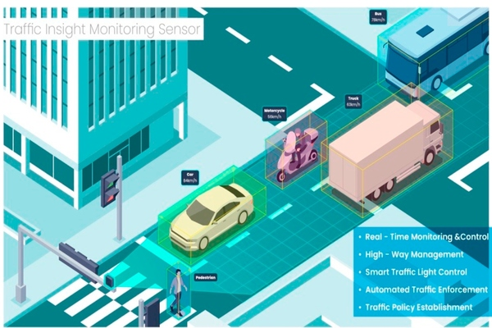
THANK YOU!

